Slide 1



Tata Steel Prashikshan
WPS
Deep Analysis on Learners Data
Presented By:
Kanishk Shukla

Slide 2
Acknowledgement
I would like to extend my sincere gratitude to Tata Steel for providing the comprehensive dataset, which was essential for this analysis. Special thanks to Mr. Sourav Ghosh for his invaluable guidance and support throughout this project. This work would not have been possible without his mentorship and the detailed data from Tata Steel. Thank you.

Slide 3
Introduction
In this presentation, I have derived insights and conducted a comparative analysis on the dataset provided by Tata Steel. This dataset includes information on employees, their groups, divisions, and departments, as well as the specific programs and courses they have taken for skill enhancement. It details the duration of each course, whether the course was completed, enrollment and completion times, learning hours spent, course grades, and the skills learned. Through a thorough examination of this dataset, I have uncovered meaningful insights that highlight key trends and patterns in the training and development activities of Tata Steel employees.

Slide 4
Insights from the dataset
1.)
There are 12 columns and 6635 corresponding rows in the dataset with the respective employee’s department , division, group , course undertaken and course completion
3.)
There are 1738 courses in which employees were enrolled
2.)
There are 1409 Employees with 22 unique divisions and 289 departments

Slide 5
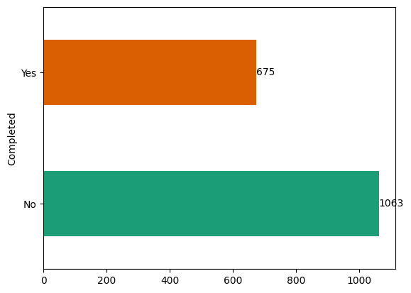
4.)
Out of 1738 courses 675 undertaken courses were completed and 1063 undertaken courses were not completed by the employees.

Slide 6
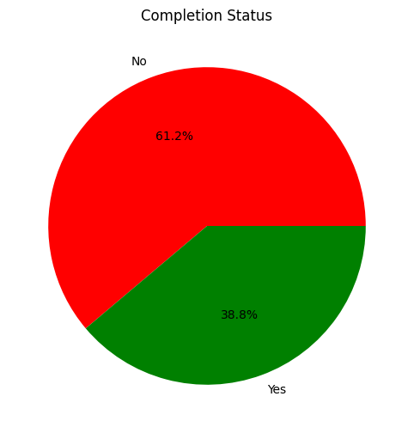
5.)
Only 38.8% of the undertaken courses were completed whereas 61.2% of the undertaken courses were not completed

Slide 7
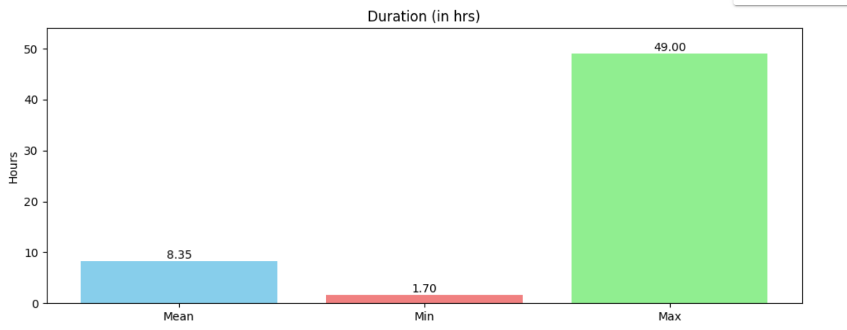
The average duration of the course is 8.35 hours and the maximum duration of a course is 49.00 hours and the minimum duration of a course is 1.70 hours
6.)

Slide 8
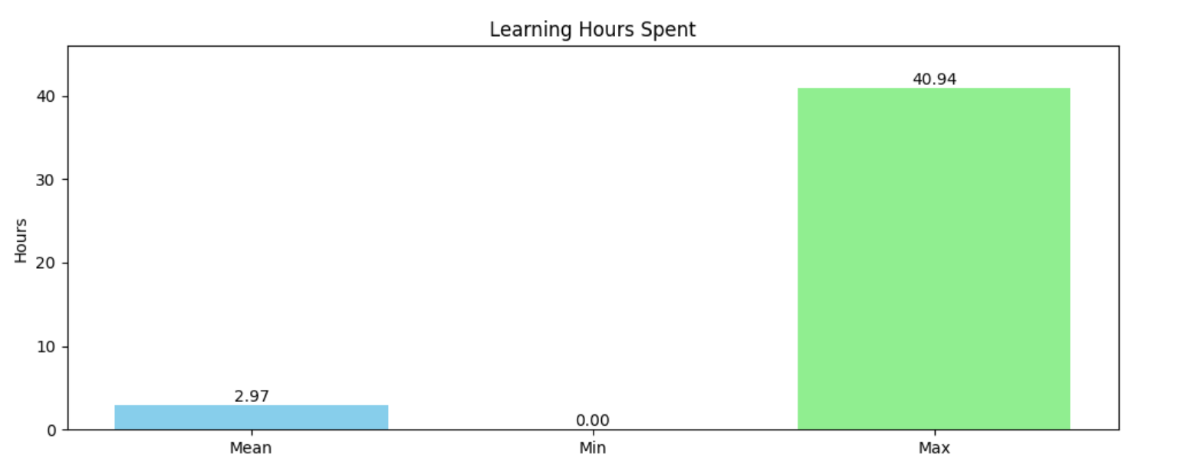
The average Learning time spent on the course is 2.97 hours . Maximum Learning time spent on a course is 40.94 hours and Minimum Learning time spent on a course is 0.00 hours
7.)

Slide 9
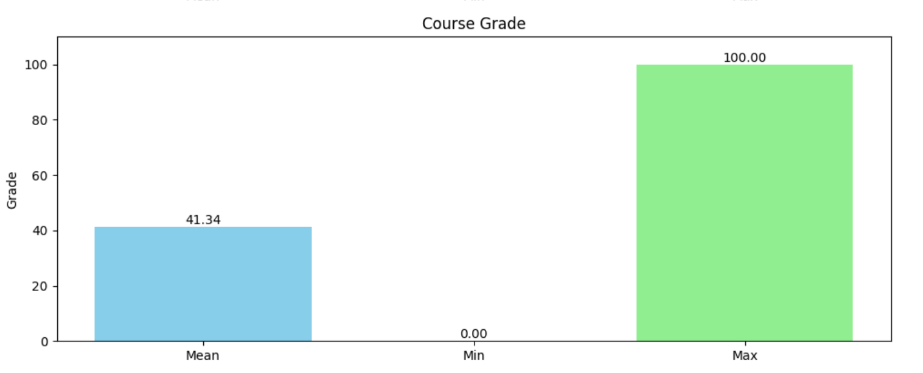
The average Course grade of the course is 41.34. Maximum Course grade of the course is 100.00 and Minimum Course grade of the course is 0.00
8.)

Slide 10
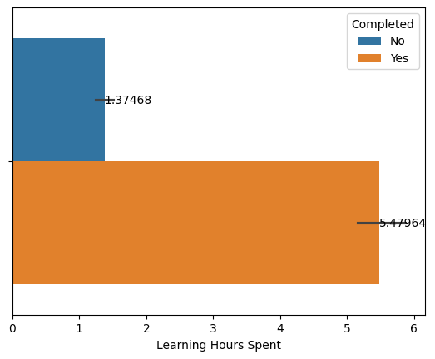
9.)
The average learning hours spent by the employees who completed the course is 5.47964 hours and the average learning hours spent by the employees is 1.37468 hours

Slide 11
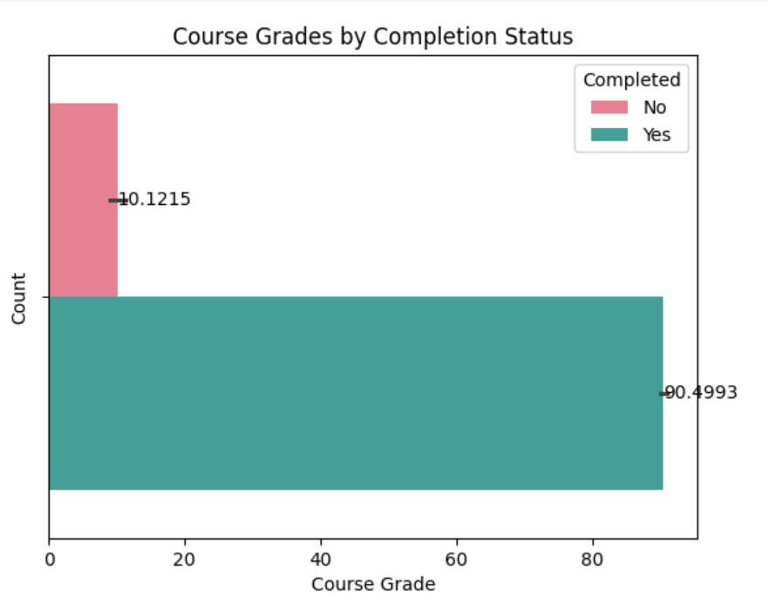
10.)
The average grade by the employees who completed the course is 90.4993 and the average grade by the employees who did not complete the course is 10.1215

Slide 12
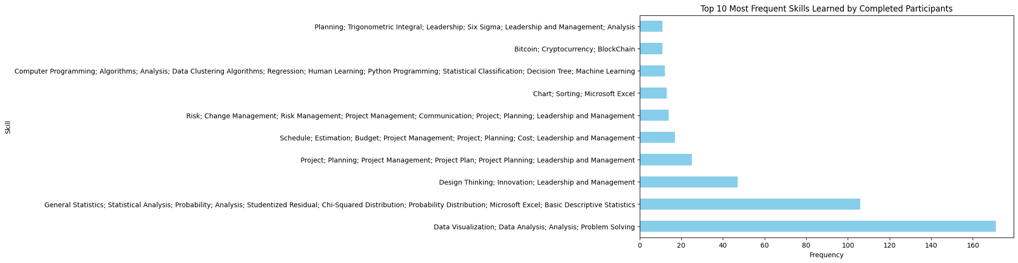
Most Pursued Course Among Completed Courses: Data – What It Is What We Can Do With It
Most Learnt Skill Among Completed Courses: Data Visualization; Data Analysis; Analysis; Problem Solving
11.)

Slide 13
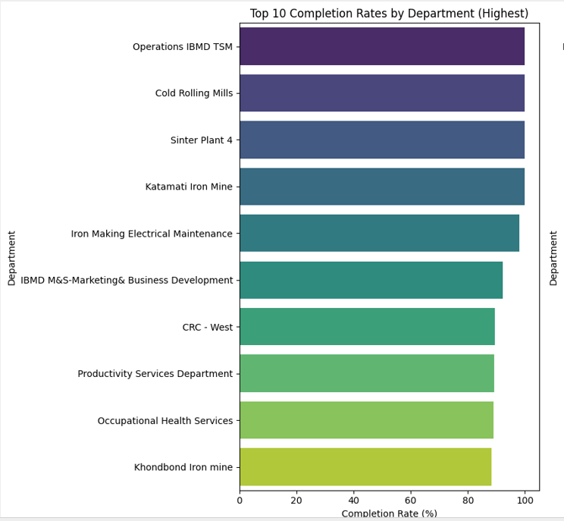
Comparative Analysis from the dataset
Top 10 Highest Completion Rates By the Department

Slide 14
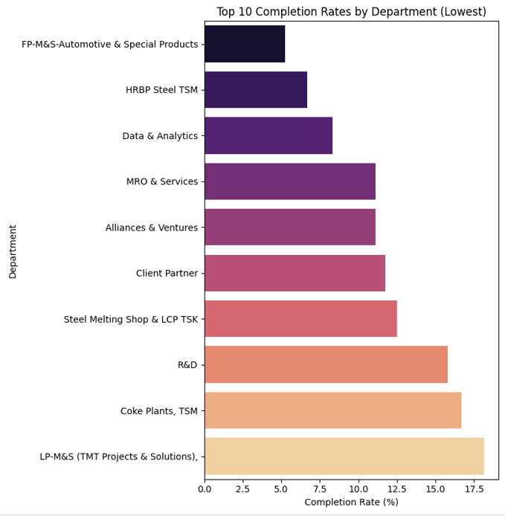
Comparative Analysis from the dataset
Top 10 lowest Completion rates by the department

Slide 15
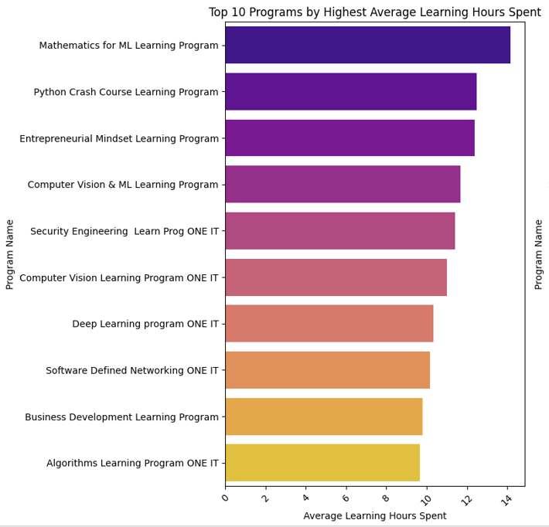
Comparative Analysis from the dataset
Top 10 Programs by Highest Average Learning Hours Spent on it

Slide 16
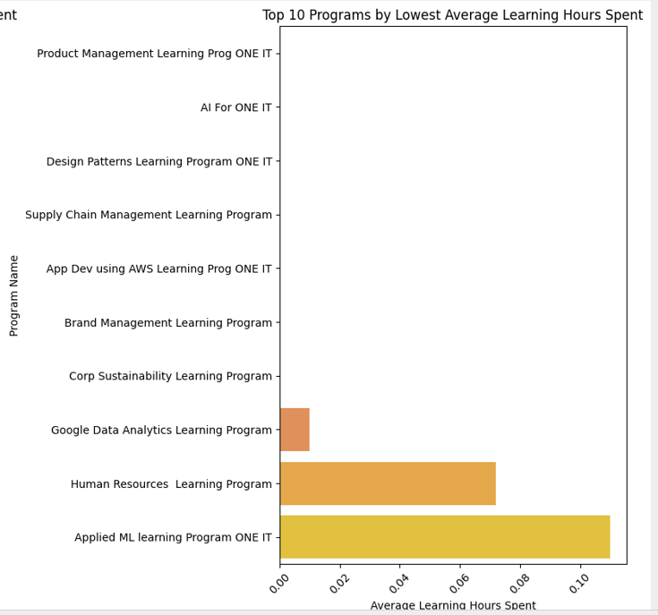
Comparative Analysis from the dataset
Top 10 Programs by Lowest Average Learning Hours Spent

Slide 17
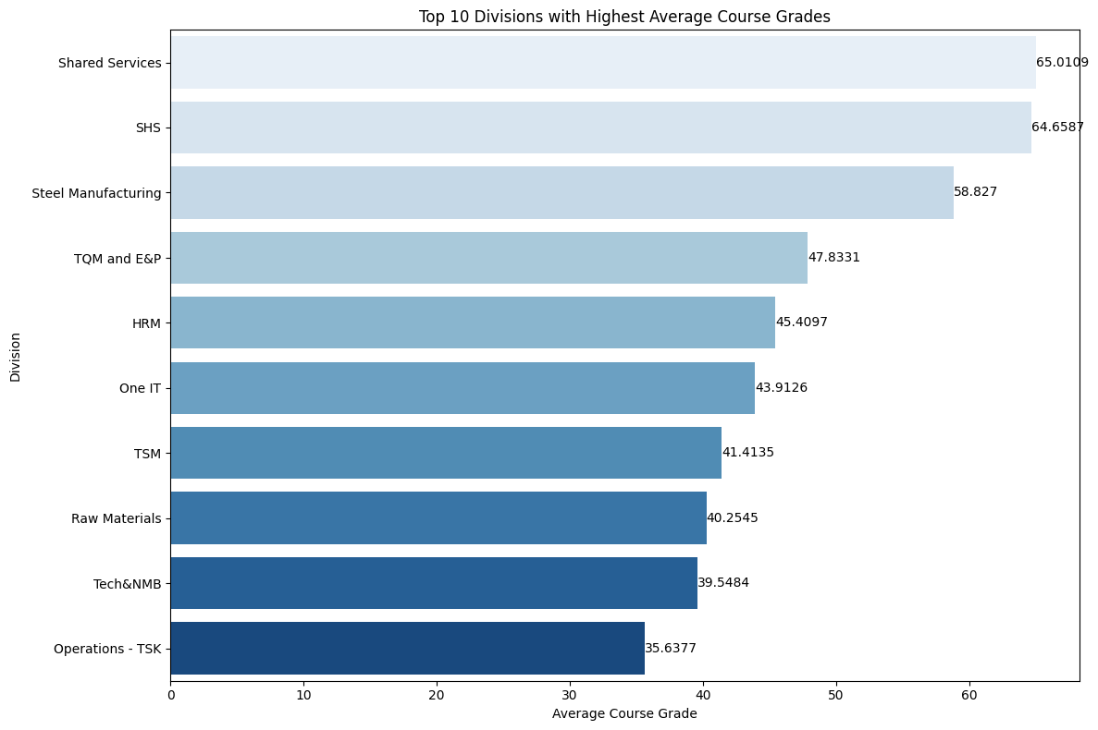
Comparative Analysis from the dataset
Top 10 Divisions by highest Average Course Grades

Slide 18
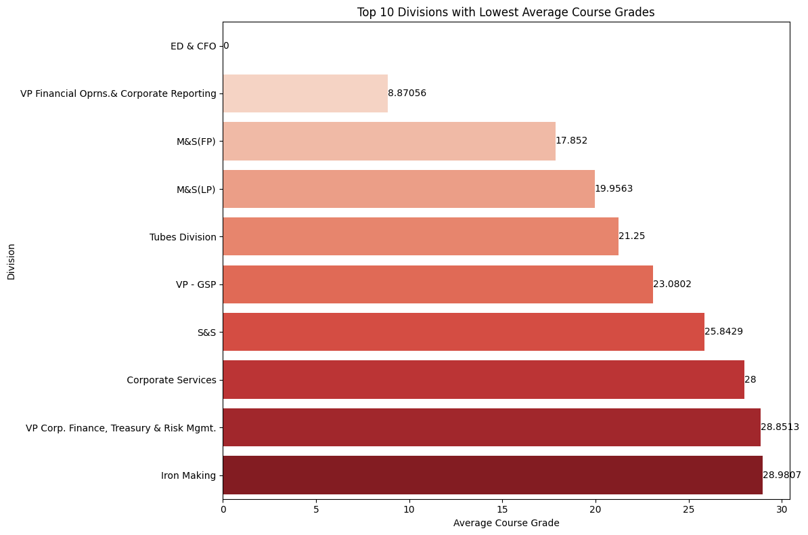
Comparative Analysis from the dataset
Top 10 Divisions by Lowest Average Course Grades

Slide 19
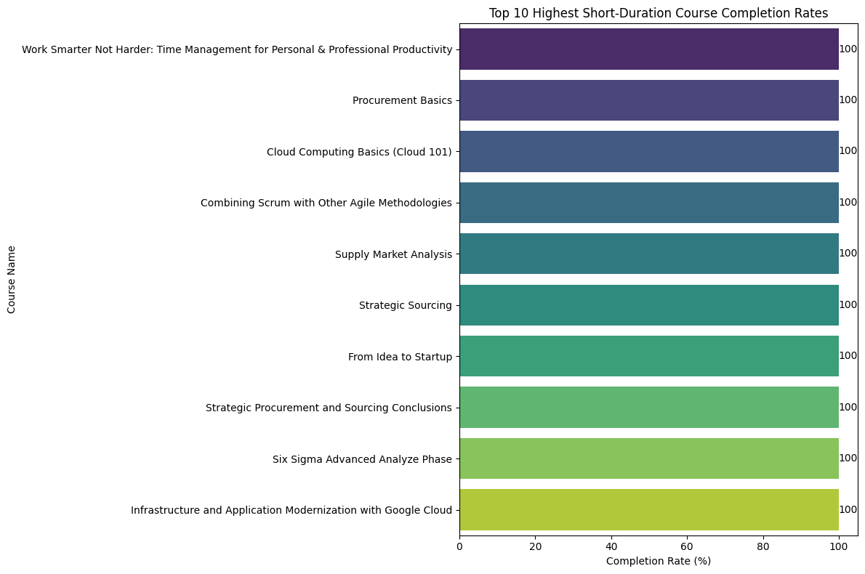
Comparative Analysis from the dataset
Top 10 Highest Short duration Course Completion Rates

Slide 20
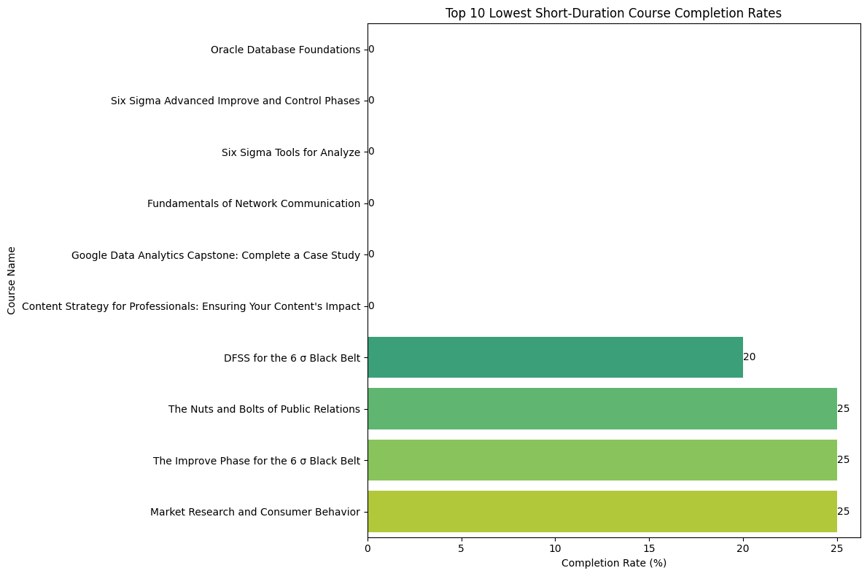
Comparative Analysis from the dataset
Top 10 Lowest Short duration Course Completion Rates

Slide 21
Overall Insights
Programs and courses that manage to achieve high grades with moderate learning hours indicate effective teaching and efficient learning processes.
Departments or divisions with low completion rates or low grades highlight areas that might benefit from additional support, revised content, or better engagement strategies.
Insights into which courses require more time can help allocate resources more effectively, ensuring that challenging courses receive the support they need.
Understanding group-specific course preferences can lead to more tailored and relevant course offerings, enhancing overall engagement and satisfaction.

Slide 22
Suggestions
Provide additional resources, such as tutoring or supplementary materials, to departments and divisions with lower completion rates or grades.
Review and adjust courses with high learning hours but low grades to ensure content is comprehensible and engaging
Develop curriculum and programs that align more closely with the preferences and needs of different employee groups, ensuring relevance and engagement.
Implement continuous monitoring and feedback mechanisms to keep improving course offerings based on employee performance and engagement data.

Slide 23
WPS
THANK YOU

